Slide 1
ADVERTISING UNIT
The Art of Selling

Slide 2
12/1/16 Introduction to Advertising
TP: Advertisers think carefully about the content, audience and purpose of their adverts to make them memorable
Bell work: In your copy books, write down as many places you can think of where you might see advertisements (for example, magazines)

Slide 3
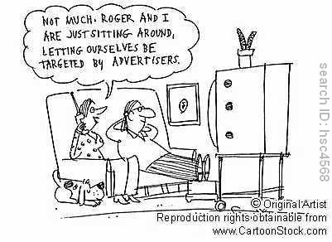
Aims
We are surrounded by adverts in our everyday lives. Whether watching television, listening to the radio, reading a magazine or simply walking down the street, we are constantly being influenced by companies trying to promote their particular product or service over another. Adverts are also be used to try to encourage us to change our lifestyle or behaviour. In this unit of work, we aim to look at the power of advertising and to design our own marketing campaign.

Slide 4
Food for Thought
Some of my favourite television adverts:
http://www.tellyads.com/play_advert/?filename=TA8253&advertiser=Cadbury&type=recent
http://www.tellyads.com/play_advert/?filename=TA8090&advertiser=CompareTheMarket.com&type=recent
Some of my most hated television adverts:
http://www.tellyads.com/play_advert/?filename=TA10840&advertiser=Plenty&type=recent
http://www.youtube.com/watch?v=2djudnKzuRM

Slide 5
Discussion Task
IN PAIRS, DISCUSS THE FOLLOWING QUESTIONS.
Think about any advertisements (radio, T.V., magazine or billboard) you have seen. What is the best advert you can remember? What made it good?
What is the worst advertisement you can remember? What made it so bad?
Why do you think you remember these advertisements and not others?

Slide 6
Content, Audience and Purpose
COPY THE FOLLOWING DEFINITIONS INTO YOUR COPY BOOKS
Content – what the advertisement is about
Audience – who the advertisement is aimed at
Purpose – what the advertisement is trying to encourage the audience to do

Slide 7
Paired Task
On the following slides are a number of advertisements. In pairs, decide on what the content, audience and purpose of each ad is.
Write your answers in your copy books.

Slide 8
Content: ________________________________________________________________
Audience: ________________________________________________________________
Purpose:
________________________________________________________________

Slide 9
Content: ____________________________________________________
Audience: ____________________________________________________
Purpose:
____________________________________________________

Slide 10
Content: ________________________________________________________________
Audience: ________________________________________________________________
Purpose:
________________________________________________________________

Slide 11
Content: ________________________________________________________________
Audience: ________________________________________________________________
Purpose:
________________________________________________________________

Slide 12
Plenary
In your copy books, write down your answers to the following question:
Why do you think
advertisers focus on
specific consumers?

Slide 13
13/1/16 Persuasive Language
TP: Good writers disguise opinions as facts to persuade the reader
Bell work: In your copy books, write down as many different words as you can that mean the same as ‘good’.

Slide 14
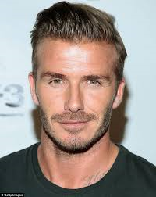
Think/Pair/Share
Below are two statements about David Beckham. What is the difference between them? Write your answers in your copy book.
David Beckham is the best football player in the world.
David Beckham scored a total of 62 goals when he played for Manchester United.

Slide 15
Advertising: the facts
While companies are not allowed to lie about the products or services they offer, they want to advertise them in such a way that encourages consumers to buy from them - as opposed to other companies.
One way of doing this is to make their opinions sound like facts to persuade the reader, e.g. ‘The great taste of Wrigley’s Spearmint’ rather than ‘We think Wrigley’s Spearmint tastes great’.
Companies also use interesting and exciting adjectives in their advertisements to make their products sound more appealing.

Slide 16
17/1/16 Persuasive Language
TP: Good writers disguise opinions as facts to persuade the reader
Bell work: Write down an example of one fact and one opinion.

Slide 17
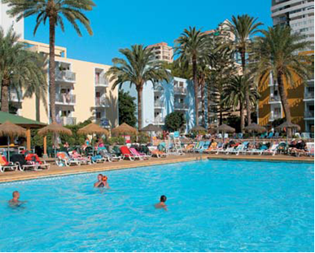
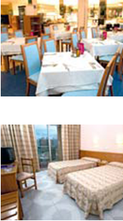
COSTA BLANCA
BENIDORM
Hotel Pueblo Benidorm ***
It’s the location that sells this place. Set in a busy corner of Benidorm, it’s just minutes from shops and restaurants. Levante Beach and the town’s weekly market are only a five-minute walk away, while the old town can be reached in about ten. The hotel itself is a large, high-rise affair. Outside, two big swimming pools sit side-by-side. They come complete with a good supply of umbrellas and sunloungers, and are surrounded by a scattering of palms.
Inside, things are modern and well-dressed. In the lobby, spot-lit ceilings are supported by marble pillars, while wooden tables are accessorized with bright flowers. The bedrooms, meanwhile, are simple but comfortable. Cue neutral walls and pine furniture. Each one comes with a satellite TV and a balcony, too.
When it comes to eating and drinking at the Pueblo, big buffets are the order of the day. Dishes on offer range from Spanish specialities to British favourites, while on-the-spot cooking stations feature at every meal. Have your omelettes cooked to order at breakfast, and help yourself to freshly-carved meat in the evenings. For after-dinner drinks, meanwhile, head to the lively lounge room.
Location • 400m to Levante Beach • 200m to nearest shops and nightlife • 800m to Benidorm Old Town
Swimming pool • 2 swimming pools • Covered heated pool • Sun terrace with sunbeds and parasols • Gardens
Meals • All meals buffet service • Tea, Healthy Living and show
cooking options at breakfast • Regional and vegetarian dishes available • Themed evenings • • Christmas Eve and New Year’s Eve gala dinners included
Activities • Full programme of activities • Pool table • Table tennis • Games room • Archery • Target shooting
Entertainment • Evening entertainment includes cabaret, dancing and music • TV lounge
For families • Children’s pool • Games • Playground • Cots
Other facilities • Internet corner • Telephone
• Air-conditioning/heating throughout • ATM
Room facilities All rooms have satellite TV, telephone, bathroom and balcony. Standard rooms have 2, 3 or 4 beds. Some rooms are located in the central block and others in 5 smaller blocks in the pool area.

Slide 18
Location • 400m to Levante Beach • 200m to nearest shops and nightlife • 800m to Benidorm Old Town
Swimming pool • 2 swimming pools • Covered heated pool • Sun terrace with sunbeds and parasols • Gardens
Meals • All meals buffet service • Tea, Healthy Living and show cooking options at breakfast • Regional and vegetarian dishes available • Themed evenings
• Christmas Eve and New Year’s Eve gala dinners included
Activities • Full programme of activities • Pool table • Table tennis • Games room • Archery • Target shooting
Entertainment • Evening entertainment includes cabaret, dancing and music • TV lounge

Slide 19
It’s the location that sells this place. Set in a busy corner of Benidorm, it’s just minutes from shops and restaurants. Levante Beach and the town’s weekly market are only a five-minute walk away. The hotel itself is a large, high-rise affair. Outside, two big swimming pools sit side-by-side. They come complete with a good supply of umbrellas and sunloungers, and are surrounded by a scattering of palms.
Inside, things are modern and well-dressed. In the lobby, spot-lit ceilings are supported by marble pillars, while wooden tables are accessorized with bright flowers. The bedrooms, meanwhile, are simple but comfortable. Cue neutral walls and pine furniture. Each one comes with a satellite TV and a balcony, too.
When it comes to eating and drinking, big buffets are the order of the day. Dishes on offer range from Spanish specialities to British favourites, while on-the-spot cooking stations feature at every meal. For after-dinner drinks, head to the lively lounge room.

Slide 20
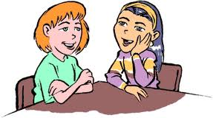
Paired Task
In pairs, read through the holiday brochure handout.
1. Underline/highlight examples of facts in one colour.
2. Underline/highlight examples of opinions in a different colour
Note: if you do not have different colours, underline facts with a straight line and opinions with a wavy line.

Slide 21
Writing Activity
In your copy books, rewrite the hotel description for the Bahia Princess, changing weak or boring words/phrases to make it sound more appealing. You can use the word bank to help you.
EXTENSION TASK: If you finish, create your own hotel description, making sure you use interesting and appealing adjectives to describe your hotel’s facilities and its location. There is a list of suggested names on your handout.

Slide 22
Self-Assessment
Take a post-it note
Write on it how easy or difficult you found the lesson
Give a reason for your answer

