Slide 1
ADVERTISING UNIT
The Art of Selling

Slide 2
22/1/14 Slogans
TP: Advertisers use slogans to help people remember products
Bell work: Below is a list of slogans for different brands. Write down as many of the brands as you can.
Just do it.
Hello tomorrow.
Try both and pick a side.
The world's local bank.
All English, all the time.

Slide 3
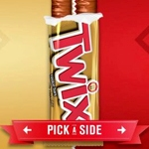
Answers
Nike
Emirates
Twix
HSBC
Melody Tunes

Slide 4
19/1/16 Slogans
TP: Advertisers use slogans to help people remember products
Bell work: Write down as many examples of advertising slogans as you can think of.

Slide 5
What is a slogan?
Copy the following definition into your copybooks:
Slogan - a short and memorable phrase used in advertising.

Slide 6
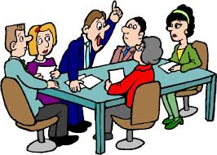
Group Discussion
Look at the slogans again. In groups, discuss the following questions. Remember, each group needs a chairperson, time keeper, recorder and reporter.
What do these slogans suggest to you/what do you take them to mean?
How did you feel on reading them?
How are they selling the product to you?
Why do you think the product/slogan was presented in this way?
Why do you think slogans are used by advertisers?

Slide 7
20/1/16 Slogans
TP: Advertisers use literary devices to make their slogans more catchy
Bell work: Can you name any literary techniques/devices? Write down as many as you can think of (e.g. simile).

Slide 8
Some Advertising Tricks
Advertisers use a number of tricks to make their slogans more catchy. Some of these tricks include the following:
Puns
Alliteration
Onomatopoeia
Simile
Metaphor
Personification

Slide 9

Pun
Copy the following definition into your copybook:
Pun – a play on words
Example: Taco Bell’s slogan ‘Think outside the bun’

Slide 10
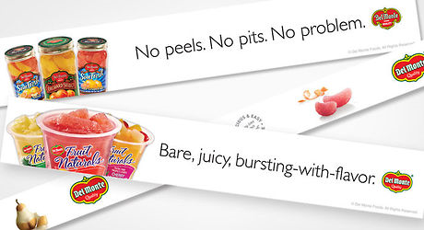
Alliteration
Copy the following definition:
Alliteration - the use of words that begin with the same sound near one another
Example: Del Monte ‘No peels. No pits. No problem.’

Slide 11
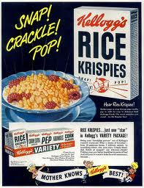
Onomatopoeia
Copy the following definition:
Onomatopoeia – words that sound like the noise they’re describing
Example: Rice Krispies
‘Snap. Crackle. Pop.’

Slide 12
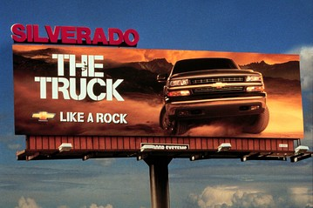
Simile
Copy the following definition:
Simile – a comparison between two different things using the word ‘like’ or ‘as’.
Example: Chevrolet Silverado ‘The truck like a rock.’

Slide 13
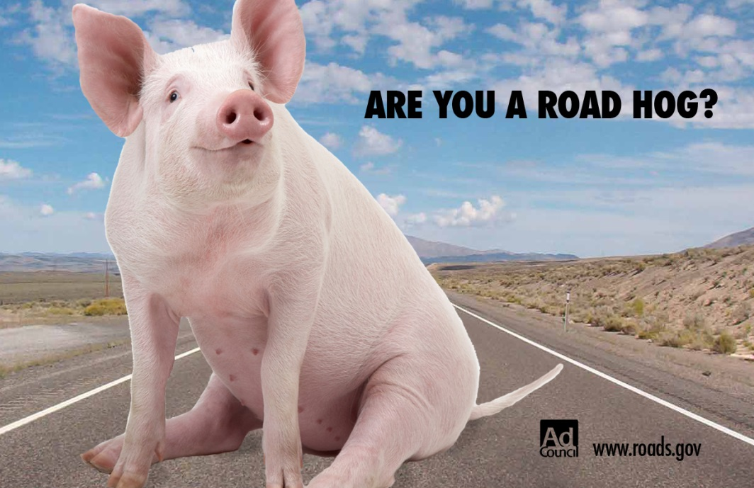
Metaphor
Copy the following definition:
A strong comparison between two different things where one thing is said to be another
Example: roads.gov ‘Are you a road hog?’

Slide 14
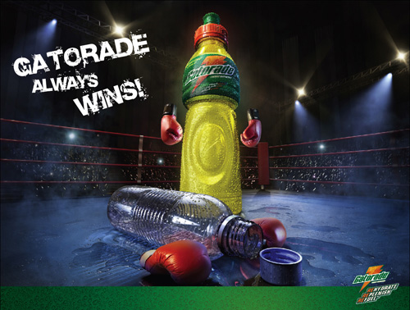
Personification
Copy the following definition:
Personification – giving human characteristics/ qualities to something
non-human (e.g. an
object or an animal)
Example: Gatorade
‘Gatorade always wins!’

Slide 15


Written Task
Advertising agents often use catchy slogans or product names to catch the consumer’s attention.
Task: In groups, come up with names and slogans for the following products. Your teacher will tell you how many different products to select from the list:
A deodorant aimed at teenage boys
A cereal bar aimed at health conscious people
A fruit juice drink aimed at kids
A shampoo aimed at middle-aged women
A new magazine aimed at celebrity worshippers
A handbag aimed at fashion lovers
A pair of trainers aimed at serious athletes
Makeup aimed at pre-teens (tweens)
Dog food aimed at concerned pet owners
A chocolate bar aimed at couples

Slide 16

Reflection
Think about the product names and slogans you heard during class feedback. On a post-it note, answer the following questions:
What product name and slogan did you like the best?
Why do you think this was better than the
others?

