Slide 1
Emotional Appeals in Persuasive Writing
How writers and advertisers use your feelings to get you to agree with them.

Slide 2
22/1/14 Emotional Appeals
TP: Advertisers use your
feelings to get you to
agree with them
Bell work: Look at the ad on the right. What do the advertisers want you to do? HOW are they trying to get you to do this?

Slide 3
24/1/16 Emotional Appeals
TP: Advertisers use your feelings to get you to agree with them
Bell work: Write down as many emotional appeals as you can remember

Slide 4
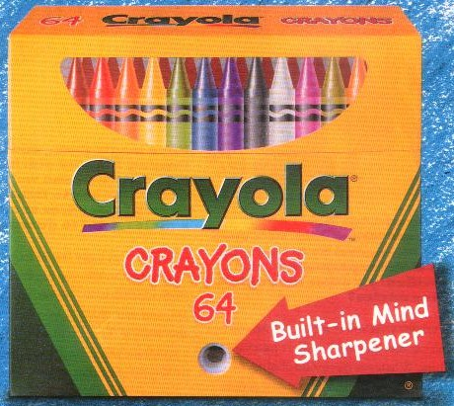
Emotional Appeals
Writers and advertisers use many techniques to convince you to agree with them or buy their product.
An emotional appeal tries to make the reader connect the writer’s message with an important feeling.

Slide 5
Types of Emotional Appeals
Loaded Language
Basic Needs
Bandwagon
Testimonial
Snob Appeal

Slide 6
Loaded Language
Copy the following into your books:
The loaded language technique uses words that cause a strong
feeling.
Once the reader is feeling strongly, he or she may be more likely to agree with the writer.

Slide 7
Class Discussion
When a mother reads the word “groovy” in this ad for a popular kids’ lunch box food, what emotion do you think she will feel?
What could this feeling make her want to do?

Slide 8
Basic Needs
Copy the following into your copybooks:
The basic needs technique appeals to your need for one or more of the following:
Love
Safety and security
Convenience
Health
Money
The writer is trying to connect your need with their opinion so that you will agree with them.

Slide 9
Think/Pair/Share
This example came from an ad for a low fat frozen dinner. What basic need does it appeal to?

Slide 10
Bandwagon
Copy the following into your book:
The bandwagon technique appeals to the reader’s need to belong and to do what everyone is doing.
Should you buy a product just because it is the most popular?

Slide 11
Testimonial
Copy the following:
The testimonial technique uses a famous person or someone who looks like a normal, average person.
The testimonial tries to connect the writer’s opinion to the reader’s feeling about this person.

Slide 12
Think/Pair/Share
This man seems like a normal, likeable guy. Why not use a celebrity for this campaign?
The text is written as if he is talking directly to the reader. Why?
The picture also uses another emotional appeal. Can you identify it?

Slide 13
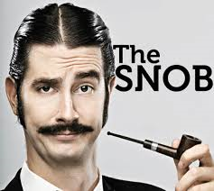
Snob Appeal
Copy the following into your copybooks:
Snob appeal is a technique that uses the reader’s desire to be better than others and connects this feeling to the writer’s opinion.
“Better” can mean more beautiful, more athletic, smarter, or richer than the average person.

Slide 14
Snob Appeal
This model is Cybill Shepherd, who is popular with older adults.
Advertisers use famous models to sell clothing because many people want to look as beautiful as the model.

Slide 15
Conclusion
Emotional appeal techniques can be extremely effective in persuading the reader to act on a feeling.
As readers of persuasive writing, we must learn to recognize emotional appeals.
If we focus on the facts instead of the feelings, we will make a better decision about the writer’s opinion.

Slide 16
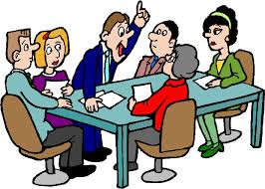
Group Task
Get into the same groups that created product names and slogans
Try to use at least 3 different emotional appeals for each of your product names:
Loaded Language
Basic Needs
Bandwagon
Testimonial
Snob Appeal

Slide 17
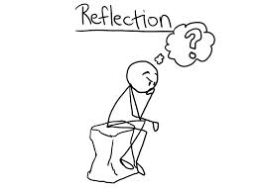
Reflection
Think about the emotional appeals you heard during class feedback.
What was the most effective emotional appeal you heard?
Why do you think this was better than
the others you heard?

