Slide 1
ADVERTISING UNIT
The Art of Selling

Slide 2









25/1/16 Success Criteria
TP: Create a success criteria for designing an advert
Bell work: Name as many of the brands below as you can:
1.
2.
3.
4.
6.
7.
5.
8.
9.
10.

Slide 3

Answers
BMW
Coca Cola
Apple
Dell
Windows
McDonald's
Adidas
Ikea
Kellogg’s
Google

Slide 4
29/1/14 Success Criteria
TP: Create a success criteria for designing an advert
Bell work: In your copybooks, write down why companies use logos.

Slide 5
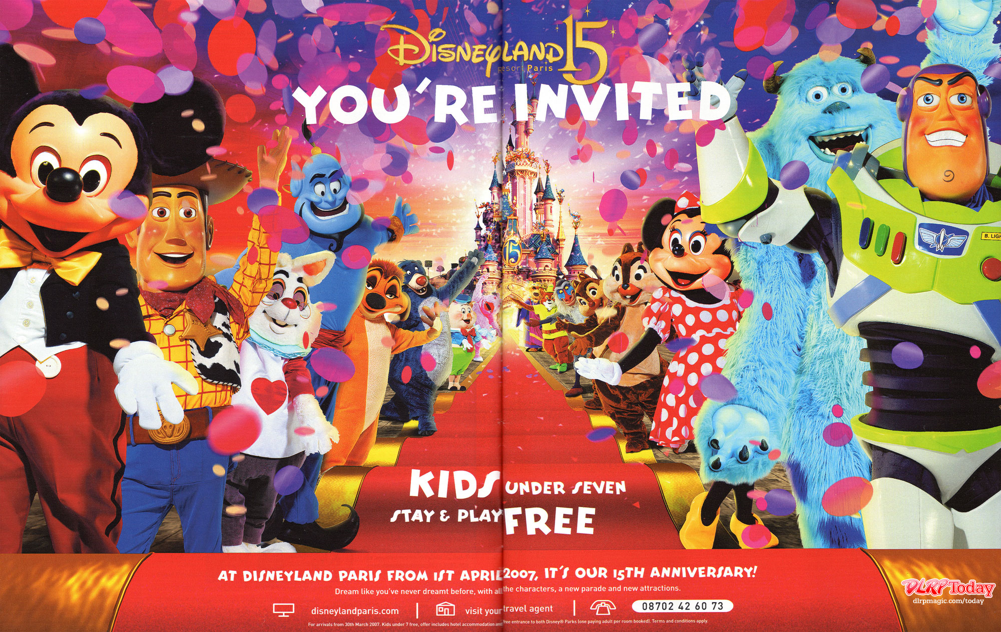

Slide 6

Group Task
In order to create an effective marketing campaign, we first need to be aware of what must be evident in this type of writing: the success criteria. Saying that a piece of writing is good or bad will not help us to improve its quality: we need to specify about what does and doesn’t work!
You are now going to work in groups to discuss what a first rate advertisement will look like. Remember that perhaps not everyone in your group will share your opinion, so don’t forget to follow the basic rules of group work:
    Elect a chairperson, note-taker, reporter and time-keeper
    Make sure that everyone in the group has a chance to give their opinion and that this is respected.
    Keep your voice to a level where others in your group can hear you but the rest of the class cannot.

Slide 7
Group Task
Look at the adverts you have been given and discuss the following questions:
How does the content/text helps to promote or sell the product. What language features do you notice that are common to many of the adverts?
Now focus purely on the layout of the page, ignoring the actual words themselves. How does the advert attract the reader’s attention? Points to consider: font size, amount of text, who or what is featured, etc.

Slide 8

8-3
Logo
Pictures of the product
Bright colours
Contact number, email, website and location
Name of the product
Exciting adjectives and adverbs
Slogan
Emotional appeal (basic needs, loaded language, etc)
Literary devices (metaphor, puns, etc)
Features and benefits
Small chunks of text
Important text in bold and/or large font
Opinions presented as facts
Written in simple to understand language
Directly addressing the reader

Slide 9
8-1
Exciting adjectives and adverbs
Contact details (email address, phone number, website)
Emotional appeals (bandwagon, snob appeal, etc)
Small chunks of text
Important info in bold/large text
Logos
Pictures of the product/service
Slogans
Literary devices (metaphor, simile, pun, etc)
Opinions as facts
Features and benefits
Bright and colourful
Easy to understand language
Direct address to reader
Name of product/hotel/service

Slide 10
8-4
Emotional appeals (testimonial, bandwagon, etc)
Attractive pictures
Literary devices (pun, metaphor, simile, etc)
Disguise opinions as facts
Logo
Product/hotel/service name
Slogan
Direct address to the reader
Bright and colourful
Features and benefits
Contact details
Powerful vocab (strong adjectives and adverbs)
Easy to understand language
Audience needs to match the product
Big/bold font for important information

Slide 11
8-2
Colourful and bright
Emotional appeals (loaded language, basic needs, etc)
Exciting use of adjectives and adverbs
Use of pictures
Contact details and location (email, website, phone, etc)
Logos
Slogans
Product name/service/restaurant
Big and bold font for important info
Literary devices (alliteration, simile, etc)
Features and benefits
Small chunks of text
Opinions as facts
Direct address to the reader
Simple to understand language

Slide 12
As a class, we are now going to create a set of success criteria by which we will be able to check how successfully we have completed the task.
8-2
1.pictures
2.Short bits of text
3. Slogans
4.Logos
5.Benefits of product/service
6.Contact details (website, email)
7.Product/service/hotel name
8.Bold text
9.Important text in large font
10.Emotional appeals
11.Bright and colourful
12.Language that is easy to understand
13.Exciting adjectives
14.Literary devices
15.Direct address to reader

Slide 13
As a class, we are now going to create a set of success criteria by which we will be able to check how successfully we have completed the task.
1.Slogans
2.Contact details (email, BBM, Twitter, telephone)
3. Pictures of products
4.Bright colours
5.Emotional appeals
6.Logos
7.Bold font
8.Location of shop/restaurant/hotel
9.Name of brand/product/shop
10. Small bits of text
11.Language is clear and easy to understand
12.Use of large text to draw attention
13. Speaks directly to the reader
14.Exciting adjectives
15.Language devices/tricks

Slide 14
As a class, we are now going to create a set of success criteria by which we will be able to check how successfully we have completed the task.
8-4
1.Bright and colourful
2.Big and clear font
3. Logo
4.Text is direct and easy to understand
5. Contact info (website, email, phone)
6. Location (of store, hotel, restaurant, etc)
7. Pictures (of product, hotel, restaurant,etc)
8. Emotional appeals (loaded language, basic needs)
9. Product name
10. Slogan
11.Language features
12.Short bits of text
13. Important words in bold
14. Direct address to reader
15. Exciting adjectives

