Slide 1

Discursive Essay Writing

Slide 2
7/3/16 Discursive Writing Introduction
TP: Understand what discursive writing is
Bell work: Create a 30 second (one paragraph) talk on ONE of the following:
Is television harmful or useful to children?
Should children be banned from playing video games?
Should teachers give homework?
Should students be made to wear uniform?

Slide 3
What is discursive writing?

Slide 4
Discursive Writing
Copy the following into your copybooks:
A discursive essay is an essay in which information about both sides of a topic or issue is put across in an unbiased way. This information is usually factual and concerned with issues in the real world.
Can you recognise the issue illustrated here?

Slide 5
Paired Activity
Come up with as many issues as you can that are going on in the world at the moment. These issues should have at least two different viewpoints.
Make sure you both write down your ideas so you each have a copy of them!
HINT: These issues can be local too!

Slide 6
17/3/14 Discursive Writing Introduction
TP: Argue one side of a particular topic
Bell work: How does a discursive essay differ from an informative? How is it different from a persuasive one?

Slide 7







What issues did you manage to come up with?

Slide 8


As a class/in groups, discuss whether or not footballers & pop stars deserve to be paid so much money.
Your teacher will tell you what side of the argument you have to present.
Discussion Task

Slide 9

What side of the argument did you find most convincing? Why?
NOTE: the most convincing side does not have to be the side you agree with.
Reflection

Slide 10
17/3/14 Research
TP: Good writers research a topic carefully
Bell work: Write down what you think the word ‘research’ means.

Slide 11
Think/ Pair/ Share
Working in pairs swap your definitions of the word ‘research’. Identify and discuss where your definitions differ.
Be prepared to give feedback to the rest of the class!

Slide 12


How can you carry out research for a discursive essay?

Slide 13
You can find information from:
Books from the library (check the non-fiction and reference sections)
The internet
Magazines
Newspapers
Television
DVDs
And don’t forget, you can ask parents, carers, brothers, sisters, friends, relatives…the list goes on!

Slide 14
When you are first presented with a written source of information, how should you evaluate the source?
You should consider whether the information is:
accurate
biased or balanced
relevant
reliable
supported by evidence
up-to-date

Slide 15


How do you know if the information you have found is all of the following?
Class Discussion
accurate
biased or balanced
relevant
reliable
supported by evidence
up-to-date

Slide 16
Ask yourself…
When was the book or article written? Depending on the topic you are researching if it is several years old it may already be out of date.
Who produced the information? An expert in their field, a journalist writing for a quality newspaper, a well known organisation or public institution (e.g. The Supreme Education Council) tend to be the most reliable sources of information.
Does the author/writer refer to a known authority or expert who agrees with their point of view to support claims they make? Do they use statistics to back up their points?
Or does the source mainly contain the writer’s own opinions rather than facts?

Slide 17
Group Task
Draw a table in your copybooks with three columns.
Give the first column the heading ‘What I know’, the second column ‘What I would like to know’ and the third, ‘What I have learned’
In your groups, discuss what you know about the 2022 World Cup. Fill out the first column of your table.
Once you have written down everything you already know, fill out the second column with questions about the 2022 World Cup that you don’t know the answers to (For example, ‘How much will it cost to host the World Cup?’)

Slide 18

Homework
Research the answers to the questions you created in your groups and then fill out the third column in your table.

Slide 19
What do you think is the best source of information? Why?
Reflection

Slide 20

18/3/14 Note-Taking
TP: Good writers know how to take notes effectively
Bell work: Write down as many situations as you can think of when you take notes (for example, writing a shopping list)

Slide 21
What did you come up with?

Slide 22

Note Taking Skills
Keywords
It is very time-consuming to write down everything that you see or hear.
Write down just the most important points.
Copy down accurately and in your own words
Writing your notes under headings will make them easier to understand later.

Slide 23

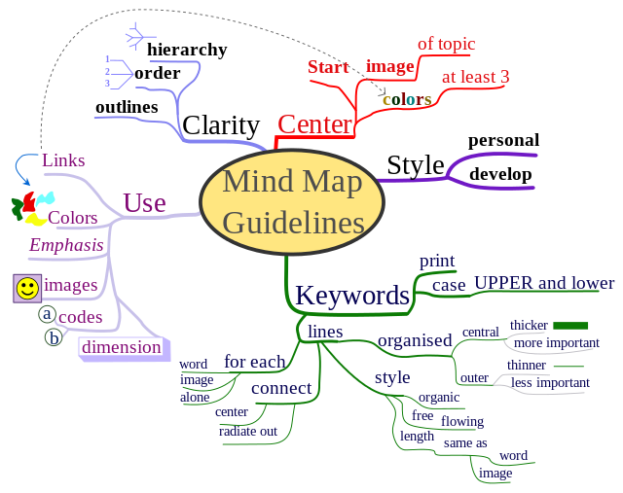
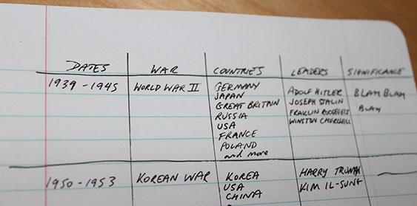
Note Taking Method
You might choose to make notes in a variety of ways:
Mindmapping
Headings and bullet points
Chart method

Slide 24
Pair Activity
    Create a table in your copy book with two columns: FOR and AGAINST.
    Discuss the question ‘Should Qatar be allowed to host the 2022 World Cup?’
    Write down as many arguments in the ‘FOR’ column as you can think of.
    Then write down as many ‘AGAINST’ arguments as you can.

Slide 25
Group Activity
    You are now going to carry out research on the topic of the 2022 World Cup.
    Take notes from the information packs you have been given.
    Use the note taking method you like best.
    IMPORTANT: each group member MUST take their own notes.

Slide 26

What you are looking for:
Background information on your topic.
Arguments in support of your topic.
Arguments against your topic.
  Remember to take a note of the source you find the information from!

Slide 27
Homework
Bring in any articles/information sources you can find about the 2022 World Cup.

Slide 28
What was the most interesting fact you learned today?
Reflection

Slide 29
25/3/14 Note-Taking
TP: Make notes about our essay topic
Bell work: What note taking skills and methods will help you to take good notes?

Slide 30
25/3/14 Note-Taking
TP: Make notes about our essay topic
Bell work: What was the most interesting argument you discussed in the last lesson (either for or against the World Cup being in Qatar)?

Slide 31
Group Activity
    You are now going to carry out research on the topic of the 2022 World Cup.
    Take notes from the information packs you have been given.
    Use the note taking method you like best.
    IMPORTANT: each group member MUST take their own notes.

Slide 32
What you are looking for:
Background information on your topic.
Evidence in support of your arguments for.
Evidence in support of your arguments against.
  Remember to take a note of the source you find the information from!
  NOTE: Do not write on the
  articles you’ve been given!!

Slide 33
How could you present your arguments for and against in a logical way in your essay? What essay structure might you follow?
Reflection

Slide 34
30/3/14 Essay Structure
TP: Good writers understand how to structure a discursive essay
Bell work: Why is it important to structure your discursive essay properly?

Slide 35
1/4/14 Essay Structure
TP: Good writers understand how to structure a discursive essay
Bell work: What are the 3 different ways you can structure your discursive essay?

Slide 36

Organising a discursive essay
There are three basic structures (ways of organising) for the discursive essay:
you argue strongly for a given discussion topic
you argue strongly against a given discussion topic
you argue about a given discussion
topic in a balanced way.

Slide 37


Arguing strongly for/against:
1. Provide an interesting introduction and make your stance in relation to the topic clear.
2. Present your first argument, with supporting evidence.
3. Provide your second argument, with supporting evidence.
4. Provide your third argument, with supporting evidence.

Slide 38
Continued…
5. Provide your fourth argument, with supporting evidence.
6. Indicate, in a single paragraph, that there is another side to this argument, with some idea of the points likely to be made for view which are opposite to your own.
7. Reiterate (state again) your position and conclude your essay.

Slide 39
Balanced:
1. Provide an interesting introduction and make your stance in relation to the topic clear.
2. Present your first argument, with supporting evidence.
3. Provide your first counter-argument, with supporting evidence.
4. Provide your second argument, with supporting evidence.

Slide 40
Continued...
5. Provide your second counter-argument, with supporting evidence.
6. Provide your third argument, with supporting evidence.
7. Provide your third counter-argument, with supporting evidence.
8. Sum up your arguments and draw a conclusion as to what side you find most convincing.

Slide 41

Thinking Point
What style do you think will work better for your essay? Why?

Slide 42
How can we start our essays?

Slide 43
Introduction:
The opening of an essay is important. It should capture the reader’s attention in some way or another. It should invite the reader to read on and create a sense of interest about the topic.
There are many ways you can do this…

Slide 44
Proactive
‘It is difficult to see how anyone can approve of fox hunting.’

Slide 45
Balanced
‘Fox hunting is a subject which people hold strongly contrasting views of.’

Slide 46
Quotation
“Oscar Wilde once described fox hunting as ‘The unspeakable in pursuit of the uneatable.’”

Slide 47
Illustration
‘On a glorious autumn morning a terrified, exhausted animal is savaged to death by a pack of baying dogs while a group of expensively dressed humans encourage the dogs in their bloody work.’

Slide 48


Anecdote
‘I have always detested fox hunting since I was almost physically sick while watching a television film of the kill at the end of a hunt.’

Slide 49
Individual Activity
You are now going to write your own introduction.
You must use one of the structures we have covered to grab your reader’s attention.
Next, you want to tell the reader what you will be discussing in your essay. In your case, you are looking at the arguments for and against Qatar hosting the 2022 World Cup.

Slide 50

Peer Assessment
Swap your opening paragraph with a partner.
Write down two things your partner has done well.
Next, write down one point for improvement.
Remember: be specific! Phrases like ‘It’s good’ or ‘It’s rubbish’ are not helpful. What in particular did you like/could be improved?

Slide 51
1/4/14 Essay Structure 2
TP: Good writers link their ideas well
Bell work: What are the different structures you could use for your discursive essay?

Slide 52
1/4/14 Essay Structure 2
TP: Good writers link their ideas well
Bell work: What are the different types of opening you could use for your discursive essay?

Slide 53
Linking Ideas in a Discursive Essay
Any well-written piece of discursive writing will flow as one continuous piece, despite being made up of three or four different arguments.
One of the techniques which can help you to achieve this effectively is the use of linking words. These words are usually used at the beginning of a new paragraph but can also be used to link ideas within a paragraph.

Slide 54
Pair Activity
    Write down as many examples of linking words/phrases as you can think of.

Slide 55
Same Line of Thought: | and, firstly, secondly, next, furthermore, likewise, in addition, similarly, also, moreover, etc.
Contrasting Ideas: | yet, on the other hand, nevertheless, however, although, conversely, otherwise, on the contrary.
Further Examples: | because, for instance, since, for example, so that, despite the fact that, accordingly, although, if, though, unless.
Definite Statements: | without question, without doubt, unquestionably, absolutely.
Conclusion/Summary: | thus, therefore, consequently, accordingly, in retrospect, hence, in conclusion, in brief, as a result, overall.

Slide 56
Expression and Tone
It is important when you write a discursive essay to write in a formal way.
You should not use an informal style to write a discursive essay.

Slide 57

Why is it important to write your essay in a formal style?
Discussion Task

Slide 58
1/4/14 Essay Structure 3
TP: Good writers write in a formal style and link their ideas well
Bell work: How can we link the paragraphs in a discursive essay? Give some examples.

Slide 59


Do | Do not use
Write in proper, complete sentences | Abbreviations (i.e./e.g./etc./UK/&)
Use complete words and expressions | Contractions (isn't/don't/won't)
Use proper, standard English | Slang (e.g. bloke/geezer etc)
 | Colloquial language (mate/bolshy etc.)

Slide 60
Pair Activity
    Read the letter on the handout you’ve been given. It is written in an informal way but it should have been written in a formal style.
    In pairs, rewrite the letter in a more formal style, using the notes provided to help you.

Slide 61
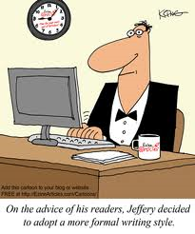
Formal Style: Example
Dear Sir,
Teenagers have just as much right to vote in the election as adults. As citizens of this country, many of us care deeply about what happens to it. Some people think teenagers are too irresponsible to make the important decisions involved in voting but many of us are far more
mature than most adults. In conclusion, we should be given a chance to prove ourselves as the mature and responsible young people we are.
Yours faithfully,
Andrew

Slide 62
2/4/14 Essay Structure 4
TP: examine the structure of a discursive essay example
Bell work: What are some differences between formal and informal style?

Slide 63
We are going to read an example of a discursive essay.
You are then going to provide detailed answers to the following questions.

Slide 64

Questions:
1. What is the main idea the writer is arguing about?
2. Each paragraph has a sub-topic which contributes to the essay's main topic: what is the key argument of each paragraph?
3. What evidence does the writer offer to support the arguments?
4. Does the writer link ideas clearly in the essay? If yes, give examples of linking words/phrases he/she uses.

Slide 65

1.The writer is trying to argue that it is time to stop using animals for scientific experimentation.
2.
Paragraph 1 - the writer introduces the argument: experiments on animals should cease.
Paragraph 2 - tests can now be done using modern technology.
Paragraph 3 - animals are different: they do not respond to tests as humans do.
Paragraph 4 - they cause animals too much pain.
Paragraph 5 - death-rate in UK has remained constant: experiments have not improved things.
Paragraph 6 - the other side of the argument: animal experiments have been useful.
Paragraph 7 - secondary argument justifies experiments: test tube tissue research is limited; whole animal testing is still needed.
Paragraph 8 - author re-states conviction that experiments are not necessary.
Paragraph 9 - conclusion: new methods needed to replace current animal testing methods.

Slide 66
3.
Paragraph 1 - not relevant: introduction.
Paragraph 2 - use of test tube technology; computers.
Paragraph 3 - aspirins affect animals badly, but not humans.
Paragraph 4 - animals given no anaesthetic.
Paragraph 5 - more long-term sickness, despite greater number of animal experiments.
Paragraph 6 - alternative arguments: benefits to diabetics, even animals.
Paragraph 7 - living tissue not as satisfactory as whole animal testing.
Paragraph 8 - Dr. Hadwen Trust re. human cartilage; research into cancer and multiple sclerosis.
Paragraph 9 - not relevant: conclusion.
4.
There is clear evidence of good linkage in the essay:
One of my main reasons...' (para 2)
'Moreover...' (para 3) clearly continues argument
'In addition...' (para 4) clearly moves argument on
'On the other hand...' (para 6) signals clearly that the writer is moving on to arguments the opposing side would offer in support of experiments
'In conclusion...' (para 9) clearly indicates argument drawing to a close

Slide 67
You are now ready to write your discursive essay!
Remember to use all of your notes and include the findings of your research…

Slide 68
7/4/14 Essay Writing
TP: write our discursive essays
Bell work: Rewrite the following introduction with correct punctuation.
thirteen years of young peoples lives are spent in school and many say these are the best years of their lives however school brings rules and boundaries including the need to wear school uniform in my opinion this is completely unnecessary

Slide 69
Corrected Version
Thirteen years of young people’s lives are spent in school, and many say these are the best years of their lives. However, school brings rules and boundaries, including the need to wear school uniform. In my opinion, this is completely unnecessary.

Slide 70
8/4/14 Essay Writing
TP: write our discursive essays
Bell work: Rewrite the following introduction with correct punctuation.
in britain we like convenience we want fast cars fast food fast internet and dont want to spend our time waiting today fifty percent of towns have five supermarkets however there are people who feel this should not be the case

Slide 71
Corrected Version
In Britain, we like convenience. We want fast food, fast cars, fast internet and don’t want to spend our time waiting. Today, fifty percent of towns have five supermarkets. However, there are people who feel this should not be the case.

Slide 72
9/4/14 Essay Writing
TP: write our discursive essays
Bell work: Rewrite the following introduction with correct punctuation.
how far would you go to have a beautiful body would you join a gym set yourself a diet plan invest in well fitting clothes all of these are perfectly safe justifiable options yet there are still those willing to risk their lives by going under the knife

Slide 73
Corrected Version
How far would you go to have a ‘beautiful’ body? Would you join a gym? Set yourself a diet plan? Invest in well-fitting clothes? All of these are perfectly safe, justifiable options, yet there are still those willing to risk their lives by going under the knife.

